Slide 1
Obfuscation Lab

Slide 2
Obfuscation Lab
Materials needed
Kali Linux Machine
Software tool used (from Kali Linux)
Python (Programming language)
This PowerPoint will be using Python3

Slide 3
Objectives Covered
Security+ Objectives (SY0-501)
Objective 3.6 - Summarize secure application development and deployment concepts
Obfuscation/camouflage
Objective 6.1 - Compare and contrast basics concepts of cryptography
Obfuscation
Objective 6.2 - Explain cryptography algorithms and their basic characteristics
Obfuscation

Slide 4
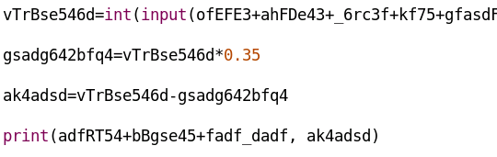
What is a Obfuscation?
Obfuscation is taking something simple and making it unclear or obscure
Take really easy code and make it very confusing
Still performs the same task
How does this help with security?
Makes it more difficult for attackers to read the code
Not impossible, just more difficult
Simple code made to look confusing

Slide 5
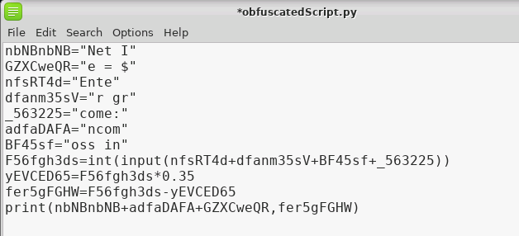
The Obfuscation Lab
Setup Environment
Write Python Script
Analyze the Script
Copy the Script
Obfuscate the Script
Run the Obfuscated Script
Compare the Scripts

Slide 6
Setup Environment
Log into your range
Open the Kali Linux Environment
You should be on your Kali Linux Desktop

Slide 7

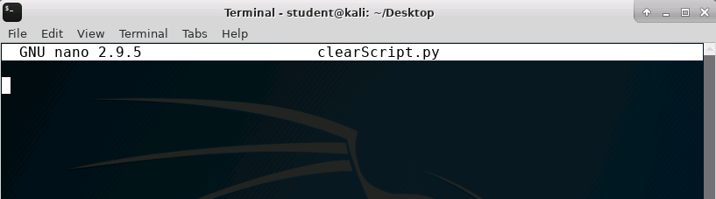
Write Python Script
Open the Terminal
Navigate to the Desktop
cd Desktop
Create a Python script on the desktop (named “clearScript.py”)
nano clearScript.py
This should open the nano editor (nothing is saved on the desktop right now)

Slide 8

Write Python Script
Write the following Python script:
grossIncome = int(input(“Enter gross income: "))
incomeTax = grossIncome * 0.35
netIncome = grossIncome - incomeTax
print("Net Income = $", netIncome)

Slide 9
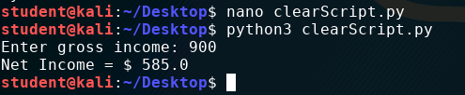
Run the Python Script
Press CTRL + x to exit the nano editor
Press y to save the file/changes
Press <ENTER> to save as clearScript.py
Now run the script*:
python3 clearScript.py
What is this program doing?
What is the tax percentage taken out of the gross income?
*Run the following to install python3 if not installed:
sudo apt-get install python3

Slide 10
Analyze the Script
What is the script doing?
Asking the user for an input with the prompt “Enter gross income: ”
Stores the user’s input as an integer for the variable “grossIncome”
Variable “incomeTax” is calculated by multiplying grossIncome by 35%
Variable netIncome found by subtracting incomeTax from grossIncome
Notice how easy it is to read this script!
Finally, it prints back to the user “Net Income = $” and the integer netIncome

Slide 11
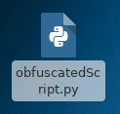
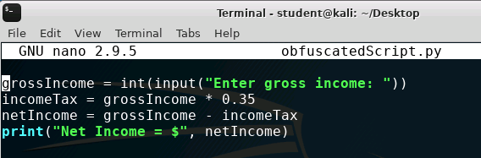
Copy the Script
In the Terminal, let’s copy the script as “obfuscatedScript.py”
cp clearScript.py obfuscatedScript.py
You should see the new obfuscatedScript.py file appear on the desktop
Open the new script in the nano editor
nano obfuscatedScript.py
File on the desktop
File in the nano editor

Slide 12
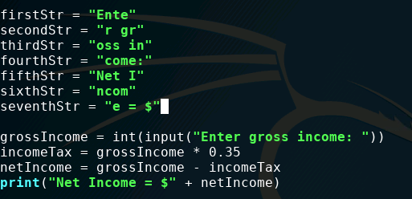
Obfuscate the Script
First, let’s break up the strings
Make 7 variables at the top and assign the strings
firstStr = “Ente”
secondStr = “r gr”
thirdStr = “oss in”
fourthStr = “come:”
fifthStr = “Net I”
sixthStr = “ncom”
seventhStr = “e = $”

Slide 13

Obfuscate the Script
Replace the strings with the variables
“Enter gross income: “ becomes the following:
firstStr + secondStr + thirdStr + fourthStr
“Net Income = $” becomes the following:
fifthStr + sixthStr + seventhStr

Slide 14
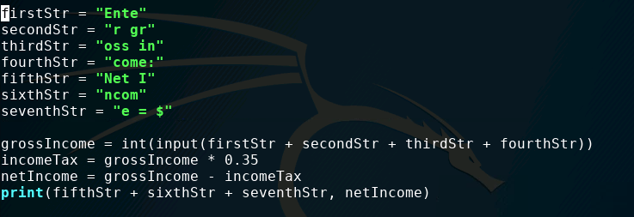
Obfuscate the Script
Check the script

Slide 15

Obfuscate the Script
Exit out of the nano editor with CTRL + x
Type y to save the changes
Press <ENTER> to keep the name change
Run the script to make sure it still works
python3 obfuscatedScript.py
Does it still work?

Slide 16
Obfuscate the Script
Let’s rename the variables, to do this use a text editor that allows a find and replace, like Leafpad
Open the script in the Leafpad text editor*
leafpad obfuscatedScript.py
This should open the script in the Leafpad text editor
*Run the following to install Leafpad if not installed:
sudo apt-get install leafpad

Slide 17
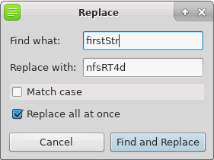
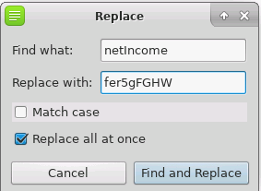
Obfuscate the Script
Under the “Search” tab, use the “Replace…” tool
Replace all the variables with scrambled names
Each new name must start with a letter (or the “_” symbol)
Don’t forget the income variables too!

Slide 18
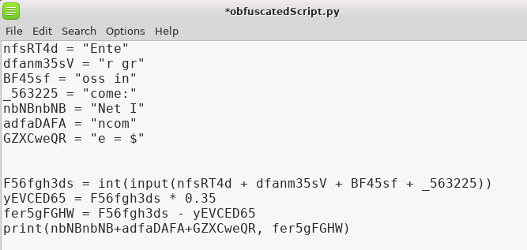
Obfuscate the Script
Your code should look something like this

Slide 19
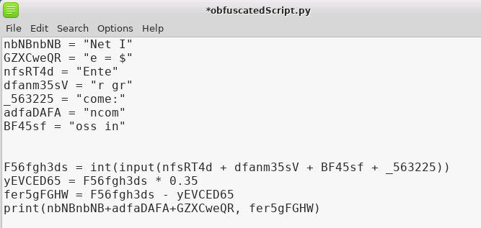
Obfuscate the Script
Mix up the top strings
Mix the order of these top strings

Slide 20
Obfuscate the Script
Get rid of all the spacing
All the spacing has been eliminated
(Except for strings inside of quotations)

Slide 21
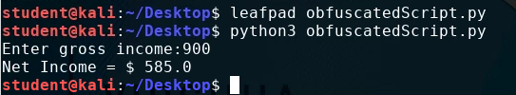
Run the Obfuscated Script
Save and exit out of Leafpad
Test the script
python3 obfuscatedScript.py
Notice it still works!

Slide 22
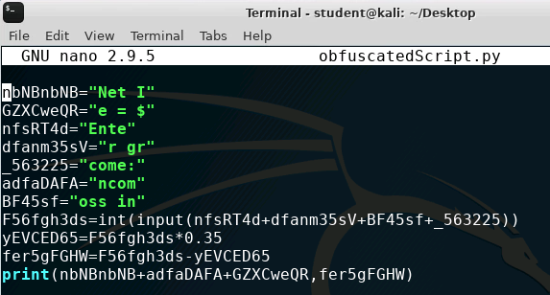
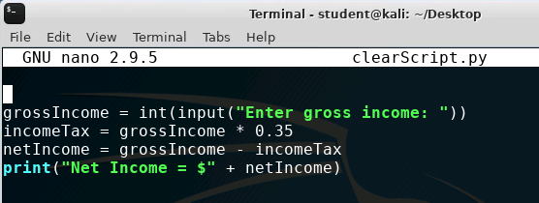
Comparing the Scripts
Both run the same program and do the same thing in the end?
How much harder is it to read the obfuscated script?

